Slide 1

Intelligent Agents

Slide 2
Contents
Agents and Environments
Concept of Rationality
Performance Measures
Rationality and Rational Agent
Task environment and its properties
Structure of Agents
Agent programs
Types of agent programs
Learning Agents

Slide 3
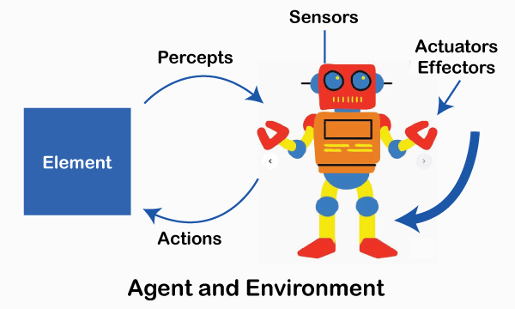
Agents and Environment
PEAS
Performance
Environment
Actuators
Sensors

Slide 4

Concept of Rationality
The quality of being based on or in accordance with reason or logic”
The ability of an agent to make the best possible decision based on the information it has, in order to achieve its goals.
Does the “right thing”
Maximizes the expected performance or utility according to information it has
Notes:
Rationality: Acting in a way that maximizes success or achieves goals.
Rational Agent: An agent that chooses the action that maximizes its performance measure.

Slide 5
Rationality and Rational Agent
Rationality
Depends on performance measures
Depends on percept sequence
Based knowledge
Deals with uncertainty
Not same as perfect
A rational agent:
Selects actions to achieve goals.
Acts optimally under uncertainty.
Uses performance measures to evaluate success.
Learns and improves over time (if it's a learning agent).
Notes:
Rationality: The idealized behavior based on perfect knowledge and computation.
1. Depends on Performance Measure
A rational agent is judged by a performance measure set by the designer.
Example:
For a self-driving car → Safety, speed, comfort, fuel usage.
2. Depends on Percept Sequence
The agent's decisions depend on all past and current inputs.
3. Based on Knowledge
An agent uses:
prior knowledge
current perceptions
built-in rules
learning experience
4. Deals with Uncertainty
Even with incomplete information, a rational agent chooses the best expected action.
5. Not the Same as Perfect
A rational agent is not required to be:
all-knowing
flawless
successful every time
It only needs to choose the best possible action based on what it knows.
Rational Agent: Makes decisions that maximize expected performance.
Example of Rationality
Example 1: Self-Driving Car
Rational action = slow down when a pedestrian is detected.
It maximizes safety → the performance measure.
Example 2: Chess AI
Rational action = move that maximizes chances of winning based on current board state.
Example 3: Vacuum Cleaner Agent
Rational action = clean the dirty square first before moving.
Key Point: Rationality doesn’t always mean perfect performance but maximizing given the constraints.

Slide 6
Task Environment and Its Properties
The environment is everything the agent interacts with or it is The situation or problem an agent is designed to address.
The environment is the external world in which the agent operates and from which it receives inputs and generates outputs.
Properties
Fully vs Partially Observable: Can the agent access all relevant information?
Deterministic vs Stochastic : Are outcomes predictable?
Episodic vs Sequential : Is each step independent or dependent on previous ones?
Static vs Dynamic: Does the environment change during operation?
Discrete vs Continuous: are there fixed action or unlimited actions?
Single agent vs multi agents : how many agent are there to make decisions ?
Known vs Unknown: not referring environment but, agent’s state of knowledge
Notes:
Definition: The situation or problem an agent is designed to address.
Properties:
Fully vs Partially Observable: Can the agent access all relevant information?
Fully Observable → Agent can see everything
Example: Chess board
Partially Observable → Agent sees only part
Example: Driving in fog
Deterministic vs Stochastic: Are outcomes predictable?
Deterministic → Next state is predictable
Example: Solving a puzzle
Stochastic → Involves randomness
Example: Stock market
Episodic vs Sequential: Is each step independent or dependent on previous ones?
Episodic → Actions don’t affect future
Example: Image classification
Sequential → Current action affects future
Example: Playing football
Static vs Dynamic: Does the environment change during operation?
Static → Environment doesn’t change while agent thinks
Example: Crossword puzzle
Dynamic → Environment changes
Example: Self-driving car
Discrete vs Continuous: Does the environment change during operation?
Discrete → Limited, countable actions
Example: Chess moves
Continuous → Uncountable actions
Example: Robot arm movement
Single-agent vs. Multi-agent:
Single-agent → Only one decision-making entity
Example: Sudoku solver
Multi-agent → Multiple agents
Example: Online multiplayer games
Example self driving car agent
Sensors Cameras, lidar, GPS \
Actuators Steering, brakes, acceleration
Environment Roads, traffic, pedestrians
Key Point: The environment defines the challenges and strategies for an agent.

Slide 7
Performance Measures
Agents are judged by using Performance measures.
  Accuracy i.e. How correctly the agent performs its tasks
  Efficiency i.e. How quickly and resourcefully the agent operates.
  Flexibility i.e. adapts to changes or new tasks.
  Robustness i.e. performs under uncertainty or errors
  Safe, fast, legal, maximize profit
Example
  For a game agent it must → win the game
  For a route planner it must tell → shortest path
  For a chatbot it must → give helpful and correct responses
  For a cleaning robot it must → area cleaned + battery usage
Notes:
The performance measure depends on the problem the agent is solving.
1. Accuracy
“How correctly the agent performs its tasks.”
Measures the correctness of outputs compared to expected results.
Critical for tasks like image recognition, language translation, and medical diagnosis.
Example:
An AI spam filter correctly classifying 98% of emails as spam or not-spam.
2. Efficiency
“How quickly and resourcefully the agent operates.”
Considers speed, memory usage, and computational cost.
Essential in real-time systems where time and resource constraints matter.
Example:
An AI assistant giving responses within milliseconds, even under heavy load.
3. Flexibility
“How well the agent adapts to changes or new tasks.”
Ability to handle dynamic environments, new goals, or unfamiliar inputs.
Important for agents working in complex, real-world scenarios.
Example:
A chatbot that can switch from booking flights to ordering food with minimal retraining.
4. Robustness
“How reliably the agent performs under uncertainty or errors.”
Measures the agent's resilience to noise, incomplete data, or unexpected inputs.
Critical in safety-critical applications like autonomous vehicles or healthcare.
Example:
A self-driving car maintaining performance in bad weather or sensor failure.

Slide 8
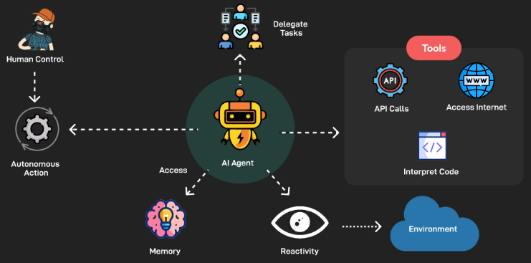
AI Agent
AI Agent = Perception + Decision-Making + Action
An AI Agent is any entity that perceives its environment, processes information, and takes actions to achieve specific goals
It :
  Receives inputs from the environment through sensors,
  Takes actions using actuators,
  And aims to maximize performance according to a given performance measure.

Slide 9
Structure of Agents
Four Components
  Sensors:
  Actuators
  Agent Program:
  Architecture
Agent Program:
A set of instructions or algorithms defining agent behavior.
Function:
Takes percepts from the environment as input and returns actions.
Notes:
Four Components:
Sensors: To perceive the environment.
Actuators: To perform actions.
Agent Program: The decision-making function.
Architecture: Hardware platform running the agent program.
Key Point: Agents use their structure to perceive, decide, and act.

Slide 10
Types of Agents
An autonomous entity that observes and acts upon an environment and directs its activity toward achieving goals
Simple Reflex Agents : Act only based on current percept.
Model-Based Reflex Agents: “Has internal memory of the world.”
Goal-Based Agents: “Thinks ahead to achieve goals.”
Utility-Based Agents : “Maximizes happiness (utility).”
Learning Agents : “Learns and improves over time.”

Slide 11
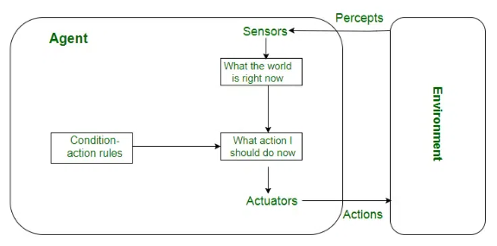
Simple Reflex Agent
“Act only based on current percept.”
How it works:
Uses condition-action rules (if-then statements).
No memory: Doesn't consider history or future.
Example:
A thermostat that turns on the heater when the temperature drops.
Notes:
Key Components of Simple Reflex Agent
Sensors: Sensors are the agent input, which gathers information about the environment, similar to our senses. Sensors can be simple bump sensors on robots to complex car cameras.
Condition-Action Rules: Simple reflex agents utilize condition-action rules to act in real-time according to their environment perception. This logic guides how the agent should react to specific conditions, which can be defined manually or learned through machine learning.
Actuators: Actuators carry out actions determined by agents, translating their decisions into physical or digital operations impacting the environment.

Slide 12
Model Based Reflex Agent
Has internal memory of the world.
How it works:
Maintains an internal state based on percept history and a model of how the world evolves.
Example:
A robot that remembers which rooms it has cleaned and plans accordingly.
Notes:
Model-Based Reflex Agents: They use a model of the world to choose their actions. They maintain an internal state.
Model: knowledge about “how the things happen in the world”.
Internal State: It is a representation of unobserved aspects of current state depending on percept history.
Updating state requires the information about
• How the world evolves.
• How the agent’s actions affect the world.

Slide 13
Goal-Based Agents
“Thinks ahead to achieve goals.”
How it works:
Chooses actions by considering future consequences and how they help achieve a defined goal.
Example:
A GPS navigation system selecting the best route to a destination.

Slide 14
Utility-Based Agents
“Maximizes happiness (utility).”
How it works:
Chooses among multiple goals based on a utility function (measure of satisfaction).
Example:
A self-driving car that considers both safety and speed to choose the best route.

Slide 15
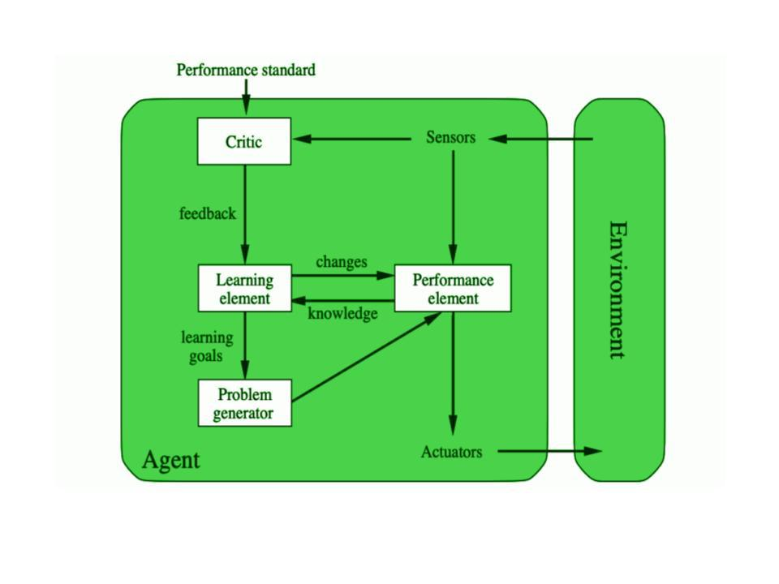
Learning Agents
“Learns and improves over time.”
How it works:
Has components for learning and improving performance from experience.
Example:
A chess-playing AI that gets better after each match by analyzing its mistakes.

Slide 16
Learning Agents
Agents that can improve their performance over time.
Components
  Learning Element: Allows the agent to modify its behavior based on experiences.
  Performance Element: Executes actions based on learned knowledge.
  Critic: Evaluates the agent’s performance.
  Problem Generator: Suggests new actions to explore.
Notes:
Definition: Agents that can improve their performance over time.
Components:
Learning Element: Allows the agent to modify its behavior based on experiences.
Performance Element: Executes actions based on learned knowledge.
Critic: Evaluates the agent’s performance.
Problem Generator: Suggests new actions to explore.
Key Point: Learning agents adapt to their environment and improve over time.

Slide 17
Summary
Intelligent agents interact with environments to achieve goals.
Rationality guides agents in making the best possible decisions
Task environments and agent programs define how agents operate.
Learning agents can evolve and improve their performance through experience.
Notes:
Sum Intelligent agents interact with environments to achieve goals.
Rationality guides agents in making the best possible decisions.
Task environments and agent programs define how agents operate.
Learning agents mary
can evolve and improve their performance through experience.

Slide 18
Questions
Define rational Agent. Explain learning agent with block diagram.
How can an agent be qualified as intelligent? Discuss various types of intelligent agents.
Explain the rational thinking as an aspect of Artificial intelligence.
Discuss task environment of autonomous car.
Is text to speech applications such as Siri, Alexa, Cortana considered as intelligent agents?
Differentiate goal based and utility-based agents with examples.
Define artificial agent. Explain PEAS for a part picking and a vacuum cleaner.
Explain the terms- agent, percept, percept sequence, agent function and agent program with example of vacuum-cleaner agent.

